Slide 1
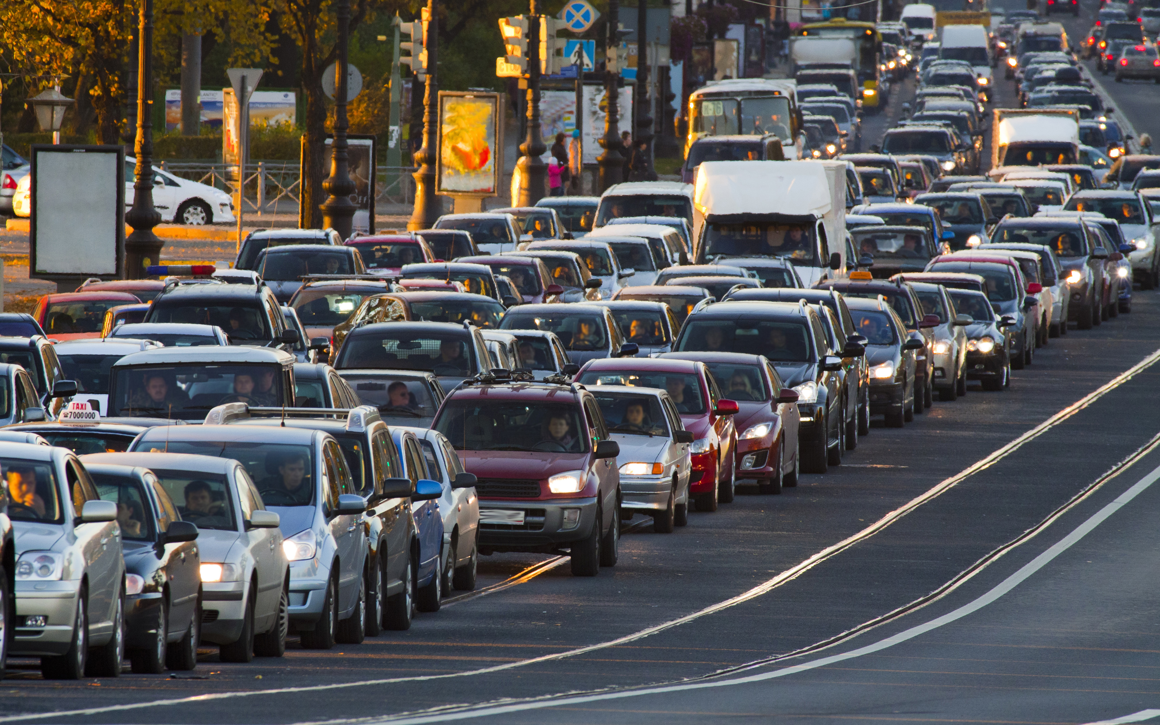
Data visualizations … for the curious
Group1: Bruno Chevalier Gilles Vandewiele Pieter Stroobant Karel Serruys

Slide 2
Overview
Context
Scope
Application
Development progress & responsibilities
Demo
Future improvements

Slide 3


Context
New UGent course!
Practicum

Slide 4

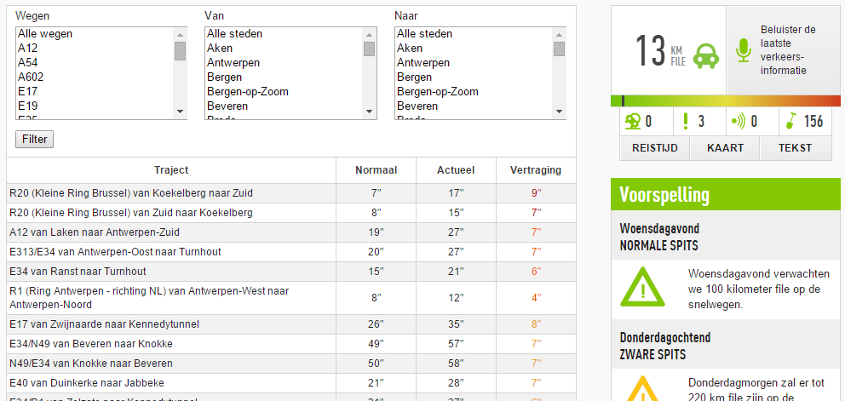
Scope: Input
Dataset

Slide 5

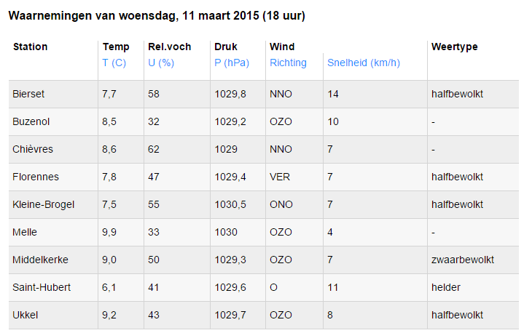
Scope: Input
Dataset

Slide 6
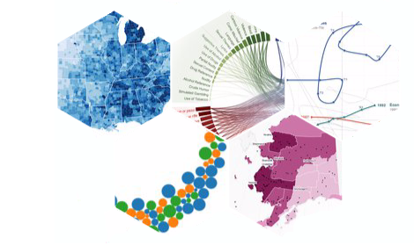


Scope: Client
User-friendly
& easy to use
Many visualizations
High speed/performance

Slide 7
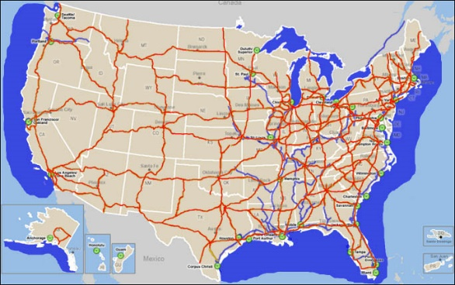

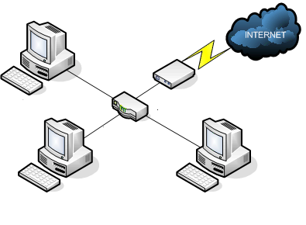
Scope: Ambition
Scalable
Generic

Slide 8


App: Server-side
scripts to cleanse & compress the data

Slide 9
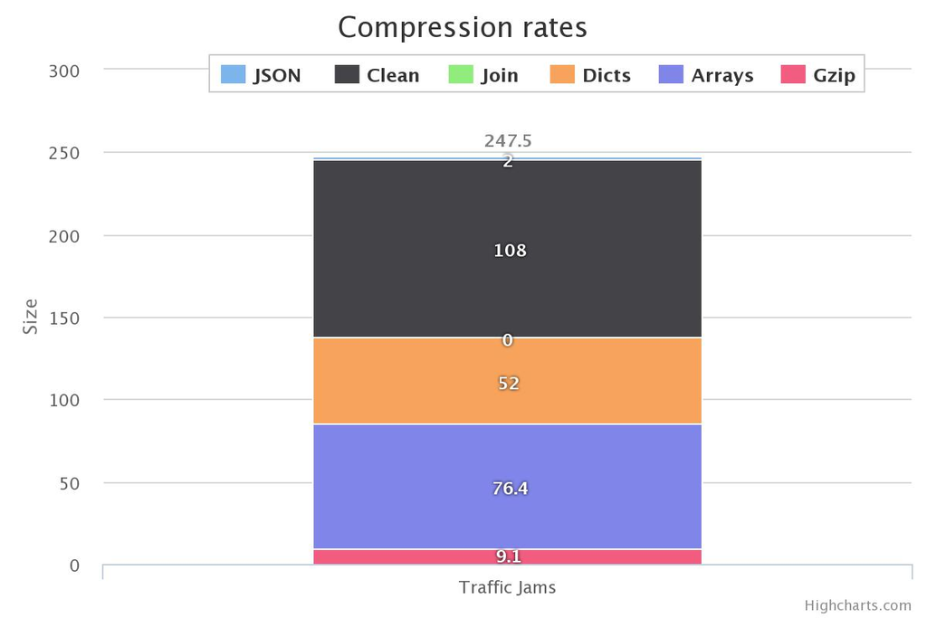



App: Data compression
Traffic jams

Slide 10
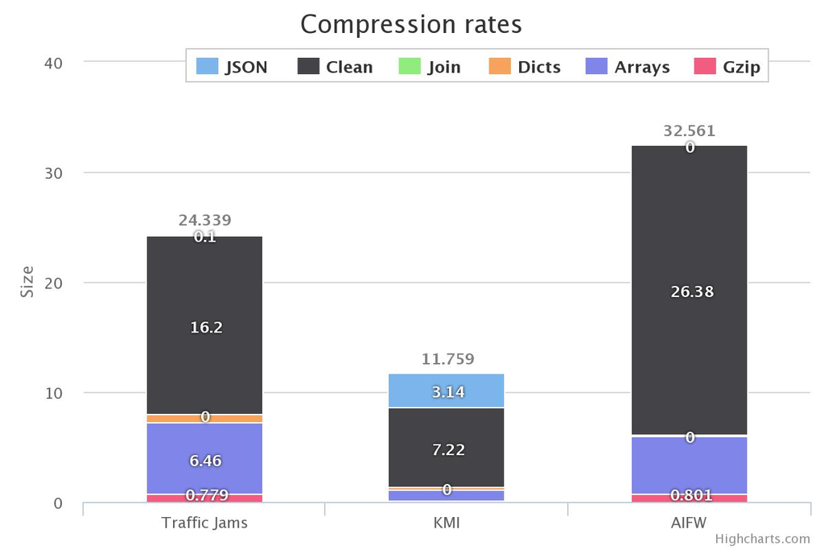
App: Data compression
KMI
AIFW
Buoy

Slide 11
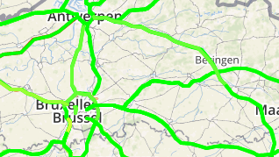
App: Geocoding
A12 van Laken naar Antwerpen-Zuid

Slide 12
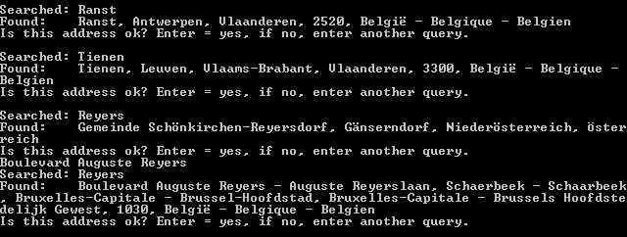
App: Geocoding

Slide 13



App: Client-side

Slide 14
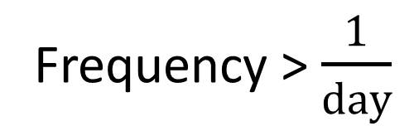
App: Constraints
Frequency > $\frac{1}{day}$
Fixed # locations

Slide 15
Development progress
Phase | Progress
Phase 1: conceptual 13/02/2015 - 26/02/1015 | Get to know the project First version of architecture Non-generic server script
Phase 2: design 26/02/2015 - 12/03/1015 | UML class & sequence diagrams Generic server script to cleanse data Research done about frameworks & libs
Phase 3: development I 12/03/2015 - 26/03/1015 | Homepage First version of start_screen Generic server script that compresses data
Phase 4: development II 26/03/2015 - 30/04/1015 | First visualizations (Map & calendar) User can add own files Finalization of script
Phase 5: finalization 30/04/2015 - 14/05/2015 | Final visualizations Code documentation & cleanup Wiki, progress report & final presentation

Slide 16
Responsibilities
Responsibility | Assigned to
Communication | Gilles
Architecture | Pieter & Gilles
Server-side script | Karel & Pieter
Framework set-up & support | Bruno
Start screen | Gilles
Calendar visualization | Bruno & Gilles
Piechart visualization | Bruno
Multiline chart | Karel
Line chart | Gilles
Bar chart | Karel
Map + timebar | Karel
Data Service | Karel, Pieter & Gilles
Progress reports + documentation | Everyone

Slide 17
DEMO

Slide 18
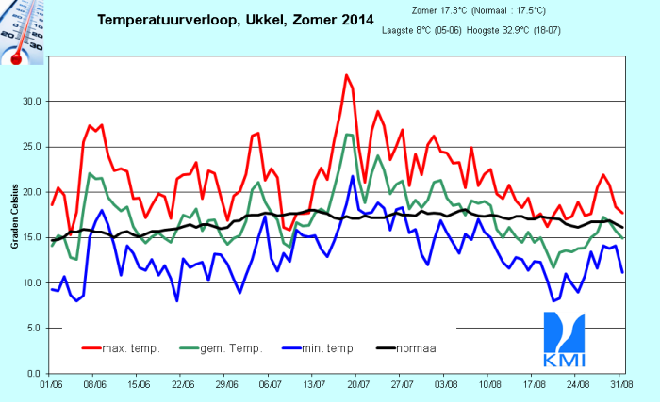
Hottest day of 2014

Slide 19
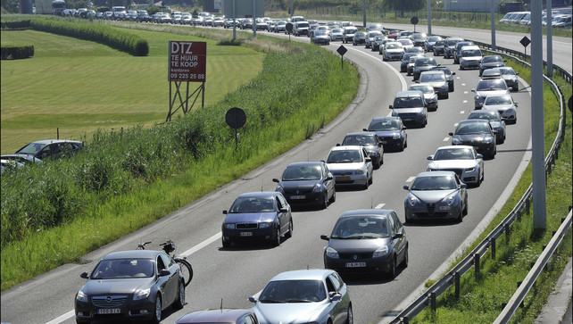
Let's go to the beach!

Slide 20
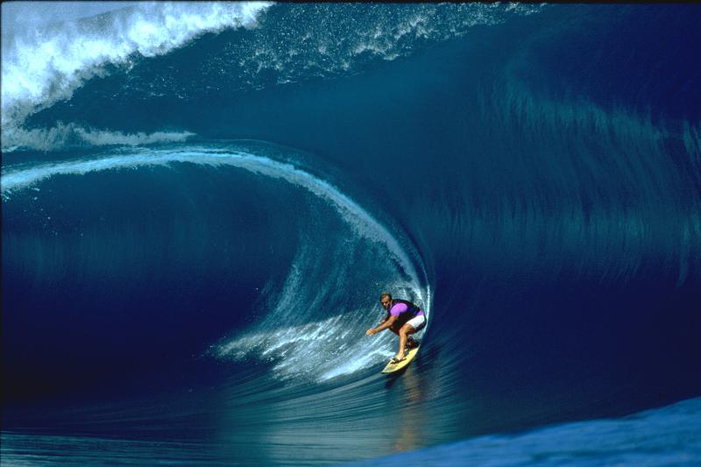

Our own data: wave heights

Slide 21
Future improvements
Multiple datasets
.gz compression
More visualizations
& dynamic discovery

Slide 22




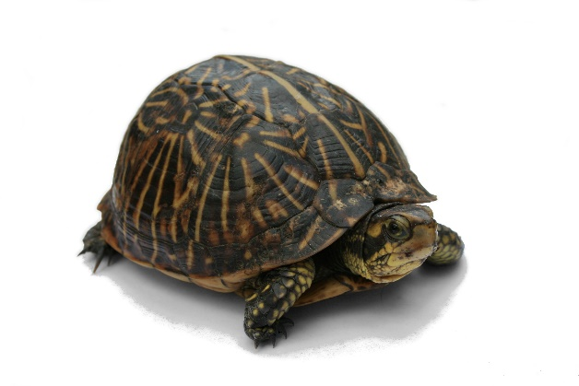
Future improvements
12
20
42
31
Count aggregation
Remove day restriction
& support data with lower frequency

